Slide 1
RAILWAY RESERAVATION SYSTEM
PROF.HUSSIAN SYED

Slide 2
CONTENTS
Introduction
Problem definition
Advantages of computerised railway reservation system
Requirement specification
Different types of diagrams
-UML diagrams

Slide 3
INTRODUCTION
PURPOSE:
To perform the online railway reservation system
The software includes the train search, train reservation and ticket cancellation.
Providing the details of the train
Printing the ticket

Slide 4
SCOPE OF THE PROJECT
The system will be designed to provide an electronic version of the railway passenger reservation system in Indian.
The objectives of this development effort are:
To provide an avenue for customers to get their tickets in a more convenient way.
To implement a prototype of a scaled down version of the final system to test the solution and further develop requirements.

Slide 5
SCOPE OF THE PROJECT
To collect statistics in a more efficient manner for future railway development and construction.
To increase efficiency of railways.
This software can be used any where and at any time at any place using only internet
Need not to have a system or a reservation centre can be accessed in mobile phone also.

Slide 6
ADVANTAGES OF THE RAILWAY RESERVATION SYSTEM ONLINE
Immediate access of the data.
Easily understandable options.
Time saving need not to go to the reservation system.
Data can be easily inserted and easily read.
Giving facilities of the enquiry of the trains.

Slide 7
UML DIAGRAMS

Slide 8
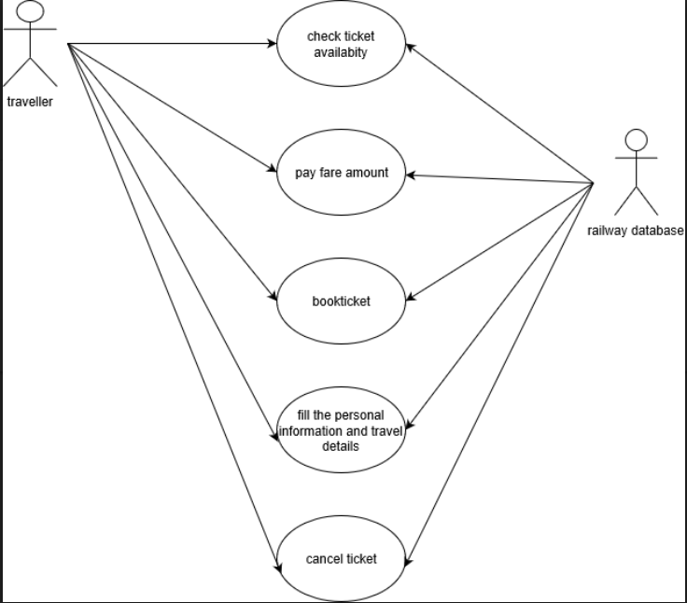
USE CASE DIAGRAM

Slide 9
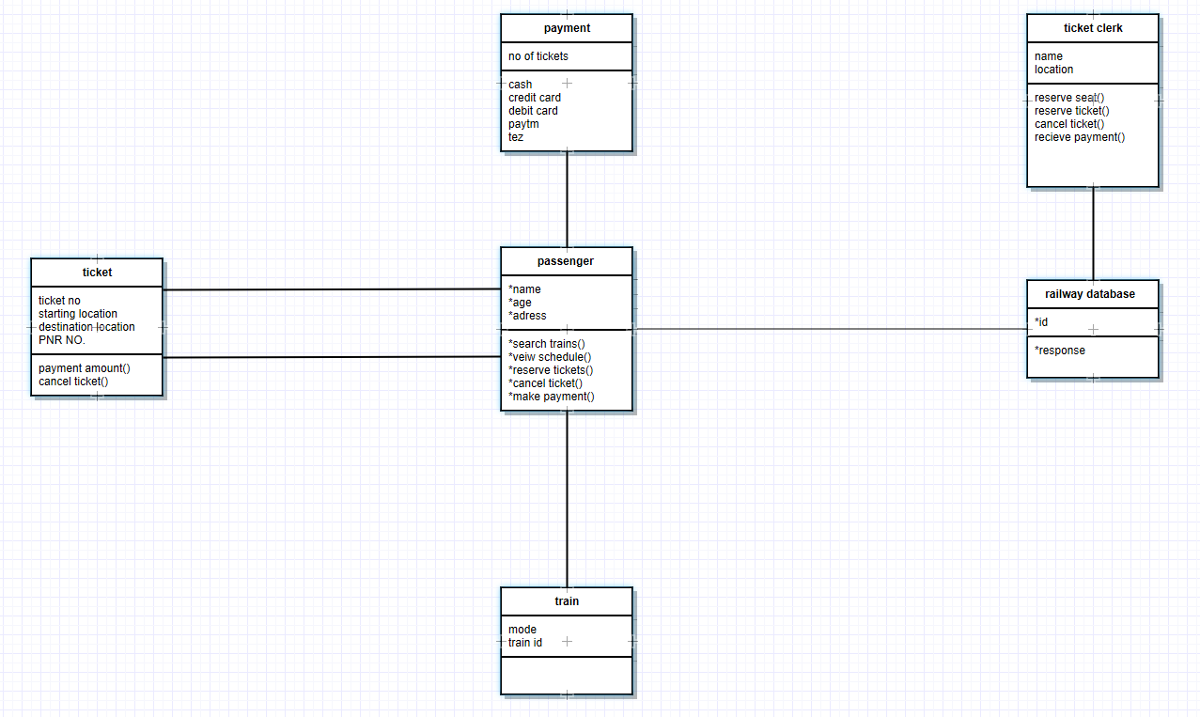
CLASS DIAGRAMS

Slide 10
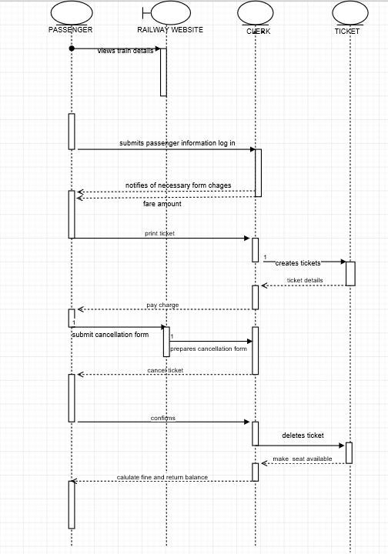
SEQUENTIAL DIAGRAM

Slide 11
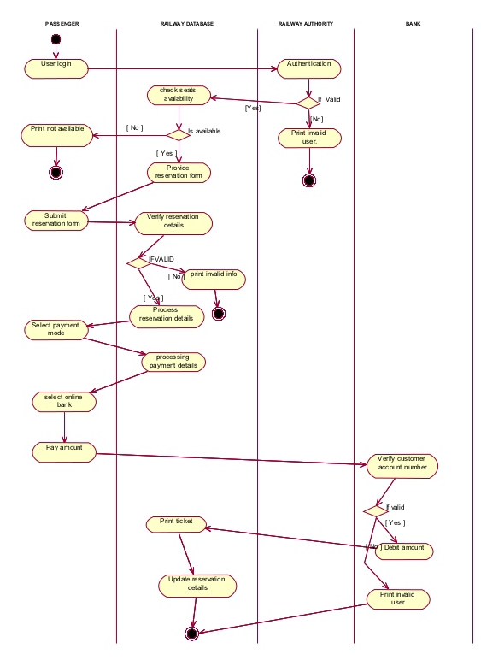
ACTIVITY DIAGRAM

Slide 12
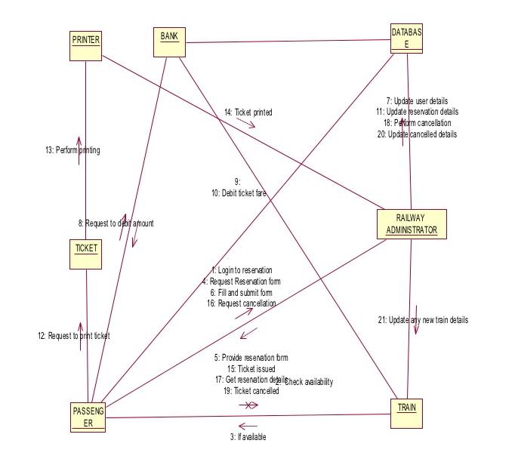
COLLABORATION DIAGRAM

Slide 13
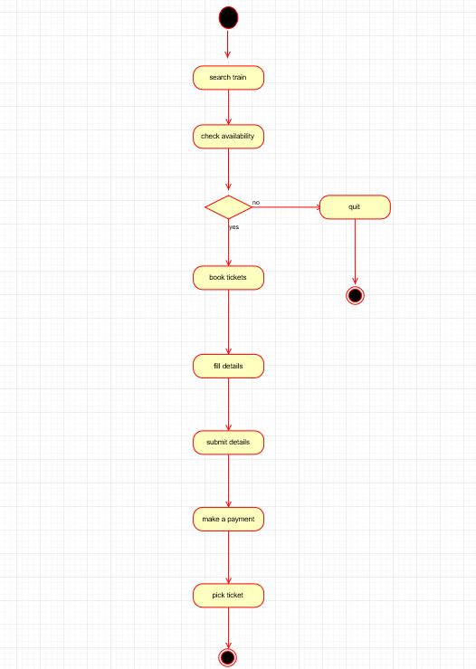
STATE DIAGRAM

Slide 14
THANK YOU

